Slide 1

About Mahindra Finance
START
Click the Start button to begin.
Notes:
Welcome to the module on About Mahindra Finance.
Click the Start button to begin.

Slide 2

Developer Notes:
Fade in the dart board image on the left along with the lead line in sync with the VO.
Fade in each bullet point in sync with the VO.
By the end of this module, you will be able to:
Express Mahindra Finance
List the product portfolio of Mahindra Finance
Describe the organization structure of Mahindra Finance
Explain the vision, mission and core values of Mahindra Finance
Explain the values and EVP of Mahindra Finance
Notes:
By the end of this module, you will be able to:
Express Mahindra Finance
List the product portfolio of Mahindra Finance
Describe the organization structure of Mahindra Finance
Explain the vision, mission and core values of Mahindra Finance
Explain the values and EVP of Mahindra Finance
https://www.freepik.com/free-vector/realistic-targets-set_6479533.htm#page=2&query=objective&position=29&from_view=search

Slide 3

Introduction to Mahindra Finance?
Developer Notes:
Introduce the guiding character on the centre of the screen when the screen loads.
As the second sentence in the VO ends, give a spin transition effect to the screen to depict time travel.
Notes:
Hi there! My name is Sadhana and I will be your guide through this module.
Let me start by taking you back in time to the early 90s.

Slide 4



Developer Notes:
As the screen loads, show the farming land as the background screen, slightly blurred.
Fade in the characters for Rajan and Priya in sync with the first sentence of the VO.
Unblur the background image in sync with the second sentence of the VO. And blend the characters image with the farm image well enough to make them look like they are standing on the farm field.
Rajan
Priya
Notes:
Rajan and his wife Priya are farmers.
They had a couple of labours working for them.
https://www.freepik.com/free-vector/indian-group-india-cartoon_4887735.htm#query=indian%20characters&position=0&from_view=search
https://www.freepik.com/premium-vector/indian-village-landscape-with-happy-farmers-working-paddy-field-farm-with-palm-trees-cartoon-men-women-standing-water-flat-vector-illustration-agriculture-farming-india-concept-banner_27572909.htm#page=2&query=farm&position=28&from_view=author

Slide 5
Developer Notes:
Move Priya (female character) to the right as the screen loads. Fade in her callout when the VO starts.
Fade out the previous callout and fade in Rajan’s callout when the VO says “ease the work…”.
Fade out the previous callout and fade in Priya’s second callout in sync with the second sentence of the VO.
I agree. It will not only ease their work, but also speed things up a bit too.
Dear, our workers are struggling to work in this hot sun. A tractor could be helpful.
But would we be able to afford a tractor?
Notes:
One day looking at the labours work under scorching heat of the sun, they realised a tractor would ease the work pressure from their workers and speed up their work on the field too.
But in those days, buying a tractor used to be an expensive and a tedious affair. Especially if you were a farmer.
https://www.freepik.com/free-vector/indian-group-india-cartoon_4887735.htm#query=indian%20characters&position=0&from_view=search
https://www.freepik.com/premium-vector/indian-village-landscape-with-happy-farmers-working-paddy-field-farm-with-palm-trees-cartoon-men-women-standing-water-flat-vector-illustration-agriculture-farming-india-concept-banner_27572909.htm#page=2&query=farm&position=28&from_view=author

Slide 6

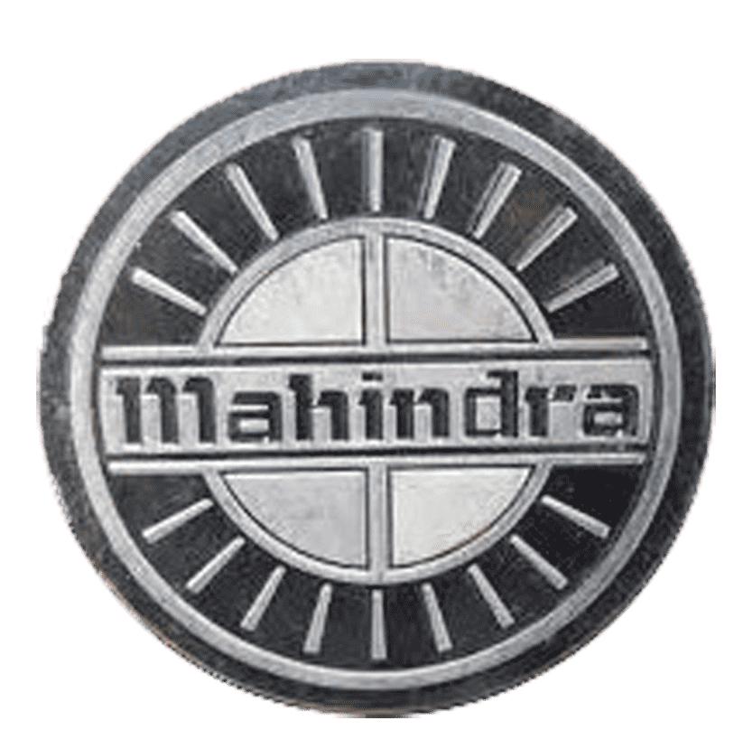

Developer Notes:
Change the background of the frame to show a showroom outlet with early 90s Mahindra logo. Keep the sales person on screen loaded along with the outlet. Fly in Rajan and Priya from left as the VO starts. Fade in Rajan’s callout when the VO says “and enquired with…”
Fade out the previous callout and fade in the first callout of the sales person in sync with the second sentence of the VO.
Fade out the previous callout and fade in the second callout of the sales person in sync with the third sentence of the VO.
Notes to Reviewer:
Move Priya (female character) to the right as the screen loads. Fade in her callout when the VO starts.
Fade out the previous callout and fade in Rajan’s callout when the VO says “ease the work…”
Namastey sir! Can regular farmers like us purchase a Mahindra tractor on easy installments?
Of course there is sir! Mahindra Finance can help you purchase your very own tractor.
Here is the list of documents you need to provide and within a couple of days, we can complete the paper work.
Notes:
They decided to go to the town and enquired with a sales person in the nearest Mahindra Vehicle’s outlet, if there’s a way to purchase the tractor via easy installments.
In response to this, the Mahindra sales person, humbly introduced them to Mahindra Finance.
He informs them regarding the required documents they needed to collate and within a couple of days, the documentation work was completed.
https://www.freepik.com/free-vector/stores-supermarkets-big-small-buildings-icons-set_3816865.htm#query=small%20store&position=24&from_view=search
https://www.freepik.com/free-vector/businessman-office-worker-character-pose-set-flat-cartoon-people-design_20730361.htm#query=salesman&position=16&from_view=search
https://listcarbrands.com/mahindra-logo/

Slide 7

Developer Notes:
Transition the screen back to Rajan and Priya’s farm. Change the background to make it look like it is evening and make the labours stand behind the tractor. Keep the tractor in the middle. Rajan and Priya on the either side of the tractor as the screen loads.
Notes:
And in a couple of weeks, they had their very own tractor running on their field.
https://www.freepik.com/free-vector/blue-tractors-design_1020638.htm#query=tractor&position=7&from_view=search

Slide 8
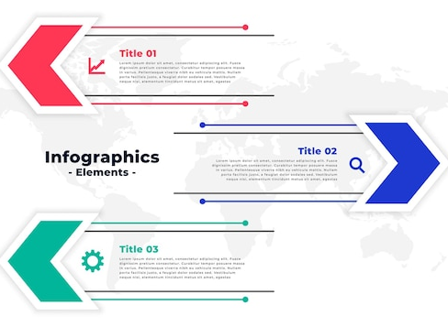
Introduction to Mahindra Finance?
Developer Notes:
Give a spinning transition effect once again to depict coming back to the present time and show the guiding character back on screen.
Fade in each component of the infographic along with its respective OST in sync with each sentence of the VO.
Began as a captive financier of Mahindra Utility Vehicles in the early 90s.
Financed Mahindra’s utility vehicles, tractors and non-Mahindra products.
Diversified into a financial services provider to the under-served customer segment in under-penetrated rural markets.
Notes:
Mahindra Finance began its journey as a captive financier of Mahindra Utility Vehicles in the early 90s itself.
They financed Mahindra’s utility vehicles, tractors and non-Mahindra products.
With time, the company diversified into a financial services provider with a whole suite of financial solutions tailored to the under-served customer segment in under-penetrated rural markets.
https://www.freepik.com/free-vector/infographic-template-arrow-style-design_15244720.htm#query=3%20points%20infographic&position=23&from_view=search

Slide 9
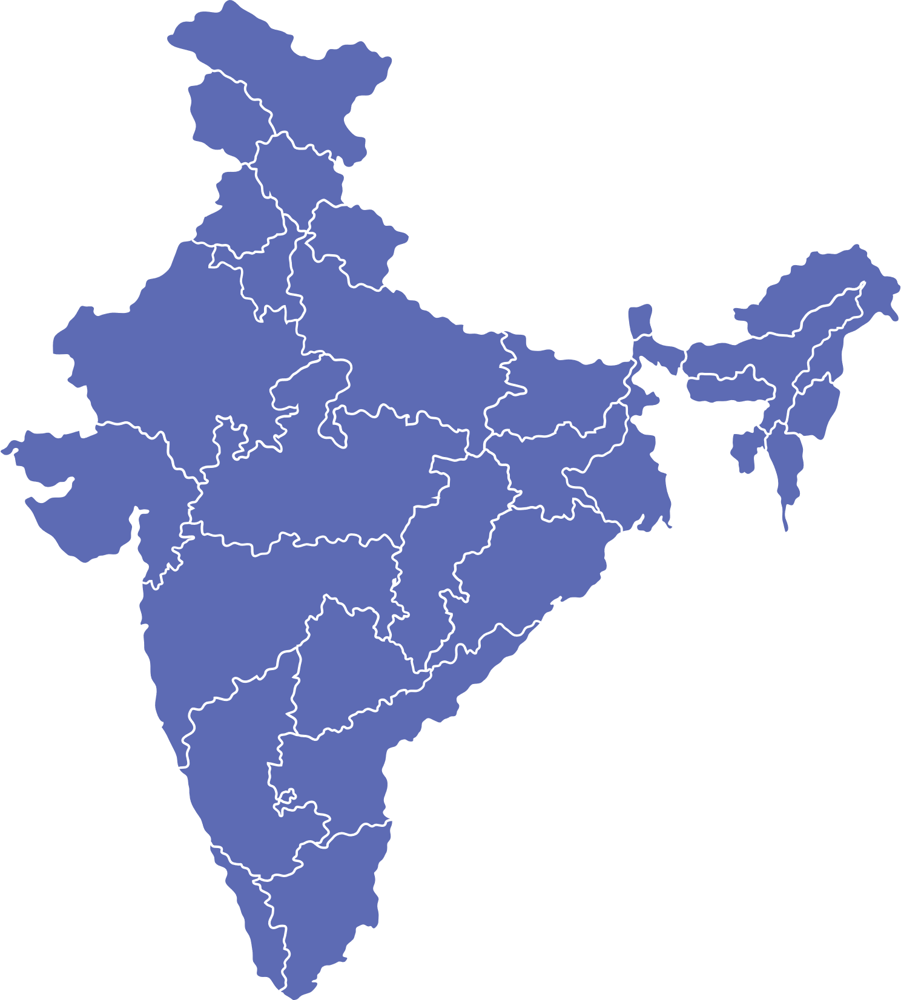
Introduction to Mahindra Finance?
Developer Notes:
Switch the guiding character’s position as the screen loads. Fade in India’s map along with the OST on top left corner in sync with the first sentence of the VO.
Fade in the OST on the top right corner in sync with the second sentence of the VO.
Fade in the OST on the bottom right corner in sync with the third sentence of the VO.
Fade in the OST on the bottom left corner in sync with the fourth sentence of the VO.
Marked its presence in every state with a footprint in 85% of its districts.
Employed more than 24000 people.
Serves customers in more than 3,80,000 villages through 1340 offices.
Made over 81,000 crore rupees worth of AUM.
Notes:
Mahindra Finance has marked its presence in every state in India with a footprint in around 85% of its districts.
It has employed more than 24000 people.
With a network of over 1340 offices, Mahindra Finance serves customers in more than 3,80,000 villages.
And it has over 81,000 crore rupees worth of assets under management (AUM).
https://www.freepik.com/free-vector/flat-india-map-infographics_12429661.htm#query=india&position=21&from_view=search

Slide 10



Introduction to Mahindra Finance?
Developer Notes:
The partition is for your reference only and not to be displayed on the screen.
Fly out the guiding character as the screen loads. Fade in the OST shown here on the left along with picture on top and bottom in sync with the first sentence of the VO.
Fade out the pictures and the OST. Fade in the OST on the top left in sync with the second sentence of the VO along with the picture on right.
Fade in the bottom OST in sync with the third sentence of the VO.
Connection with the customers and their evolving needs has been the key to its growth and success.
Catered to the financial needs of millions in rural and semi-urban India.
Pioneered several innovative financial solutions tailor-made to the earning patterns of the unique “Earn and Pay” segment that it serves.
Notes:
Since its inception, Mahindra Finance has positively catered to the financial needs of millions in rural and semi-urban India.
Its deep connection with the customers and their evolving needs has been the key to its growth and success.
The company has thus pioneered several innovative financial solutions tailor-made to the earning patterns of the unique “Earn and Pay” segment that it serves.
https://www.freepik.com/free-vector/indian-group-india-cartoon_4887724.htm#query=rural%20people&position=1&from_view=search
https://www.freepik.com/free-vector/crowd-professional-people-team-flat-poster_3797905.htm#query=people&position=2&from_view=search

